Slide 1



Geometrical UI/ UX design business CAMPAIGN
enlightening and educated our AI powered generation

Slide 2

TABLE OF CONTENTS
01
02
03
04
05
06
About us
Market analysis
Goals
we are UI / UX Designers
more in the section
Focus on the presentation of workable and practicle software produces
Content plan
Budget
Kpi overview
this will explain how we will use our oroduce to steal our customers away
our million dollar investors that are ready to help along the way to fund our ideas
You could describe the topic of the section here

Slide 3
01
ABOUT US
who are we?

Slide 4
OUR COMPANY
Company Principle: Mercury is the closest planet to the Sun and the smallest one in the Solar System—it’s only a bit larger than our Moon,

Slide 5
ABOUT THE PRODUCT
our products are widely loved as they are the only game changer on the market , offering us huge rofit due to less market investors for this field , this puts us at the top of the food chain

Slide 6
OUT GOALS
UI Design
UX design
web dev
ensuring you acquire the best user interface
ensuring you acquire the best user experience
ensuring that you acquire the best web software to boost your business or portfolios

Slide 7
WHATS SETS US APART?
Quality
Speed
the quality software we deliver
our accuracy in time in length between start to finish.
Chains of Connection
Reliability
the recognition we have built
always deliver on our promises

Slide 8
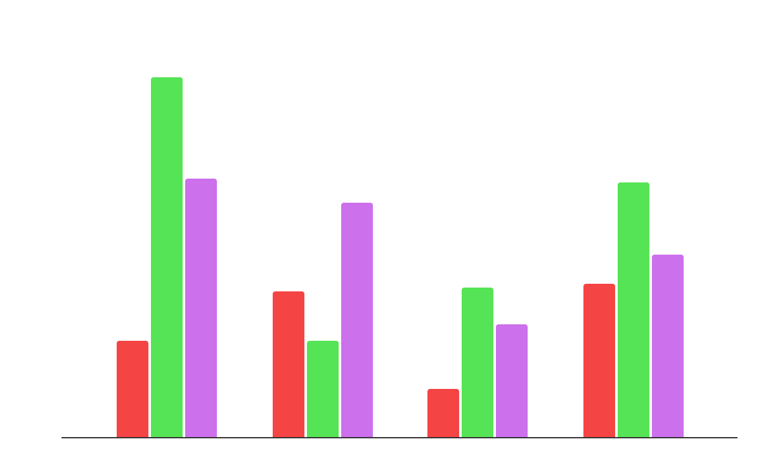
MARKET SHARE
ui design
ux design
web dev
2019
2020
2021
2022

Slide 9

A PICTURE ALWAYS REINFORCES THE CONCEPT

Slide 10
845,124
total number of satisfied customers we have have over the years

Slide 11
CORE CUSTOMER AUDIENCE
Gender
Age
60%
40%
18 - 35
80%
36 - 60
20%
Interest
20%
50%
30%

Slide 12
DISTRIBUTION CHANNEL
Premium
Wholesaler
Retailers
Retailers
Consumer
Consumer
Consumer

Slide 13

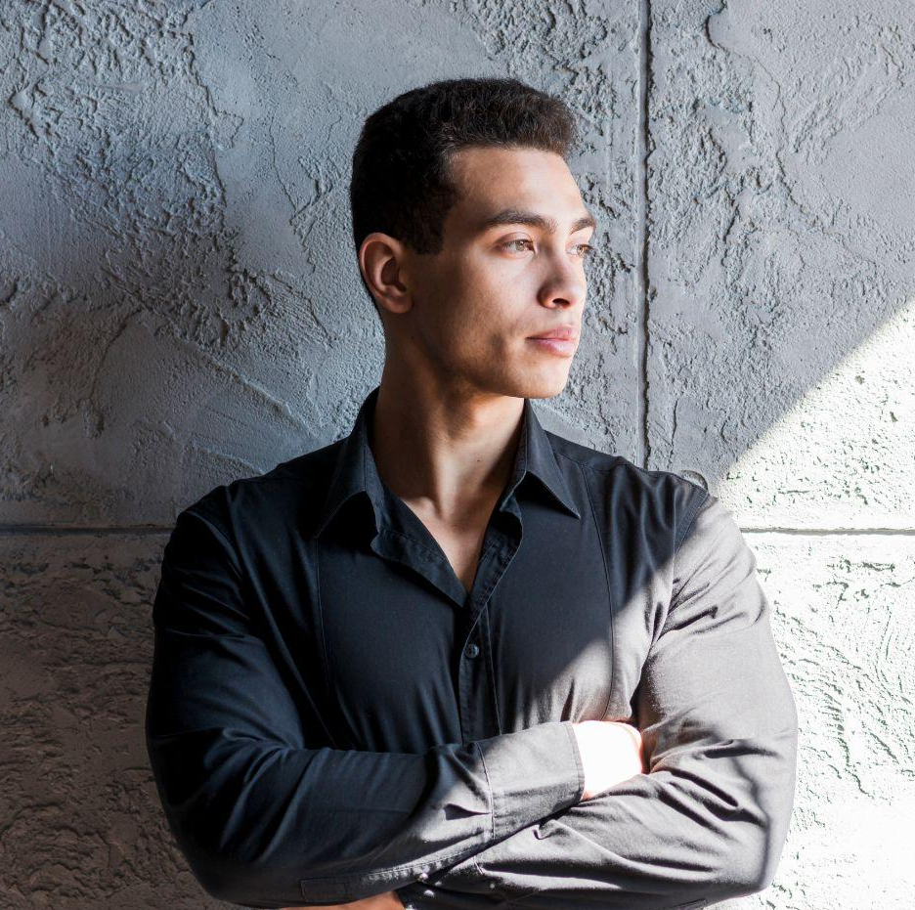
OUR TEAM
Jane Mulenga
Timmy Kasongo
lead designer for ux project
chief / lead application tester

Slide 14
Thank you

